Slide 1
Technical and Business Writing
Miss. Aqsa Ashraf
ENG-201
Week 4, Lecture 2

Slide 2
Organizing information and generation solution

Slide 3






www.tuf.edu.pk
unioffaisalabad

Slide 4

www.tuf.edu.pk
unioffaisalabad

Slide 5
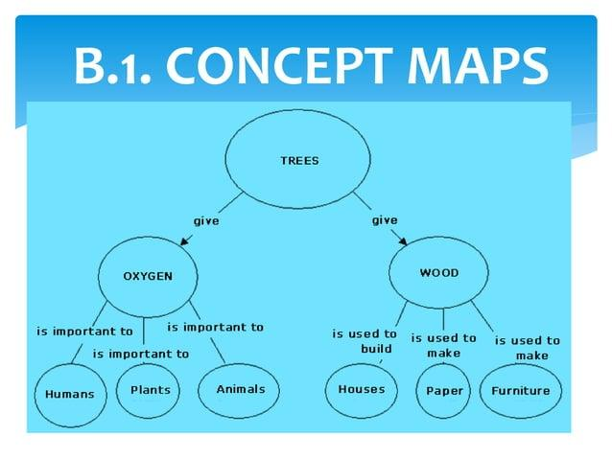
www.tuf.edu.pk
unioffaisalabad

Slide 6
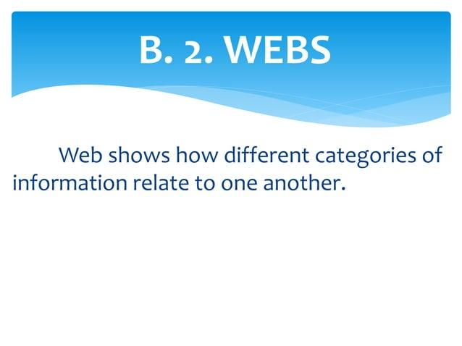
www.tuf.edu.pk
unioffaisalabad

Slide 7
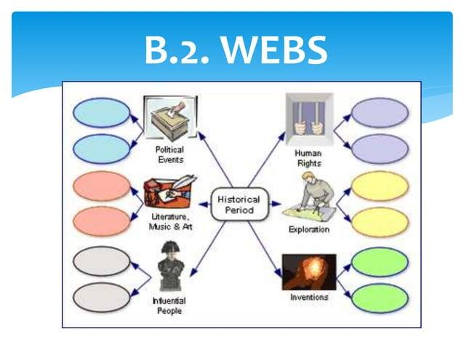
www.tuf.edu.pk
unioffaisalabad

Slide 8

www.tuf.edu.pk
unioffaisalabad

Slide 9

www.tuf.edu.pk
unioffaisalabad

Slide 10
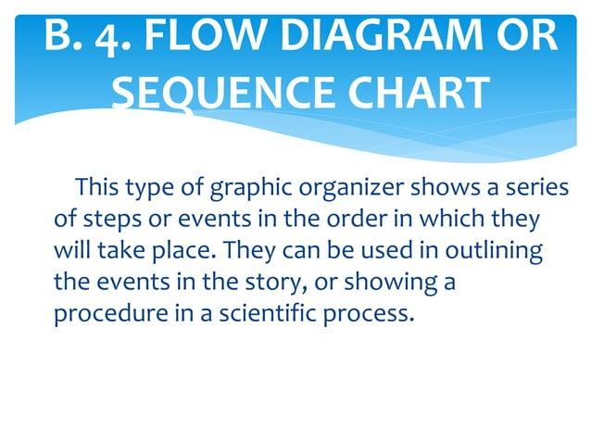
www.tuf.edu.pk
unioffaisalabad

Slide 11
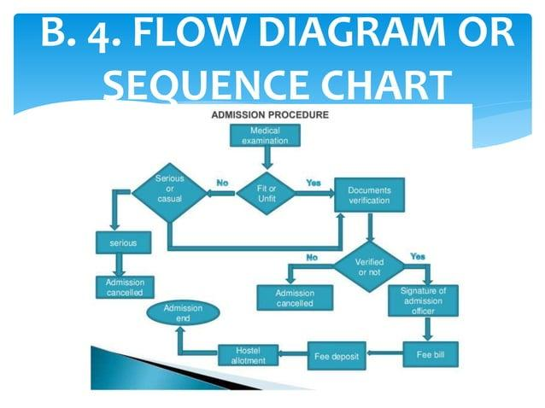
www.tuf.edu.pk
unioffaisalabad

Slide 12
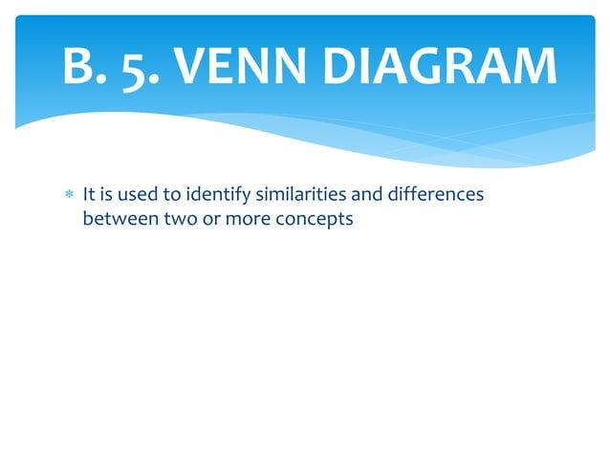
www.tuf.edu.pk
unioffaisalabad

Slide 13
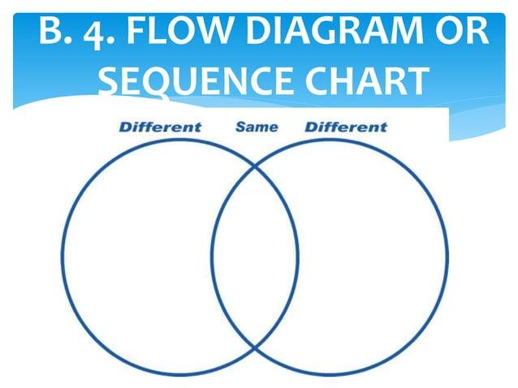
www.tuf.edu.pk
unioffaisalabad

Slide 14
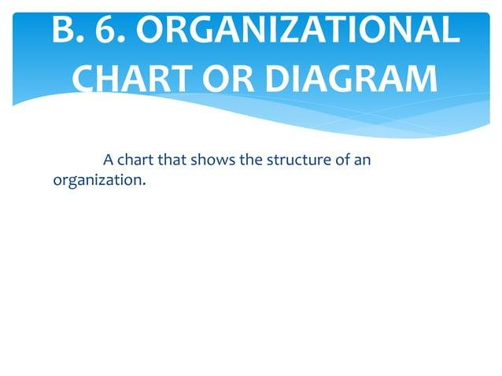
www.tuf.edu.pk
unioffaisalabad

Slide 15
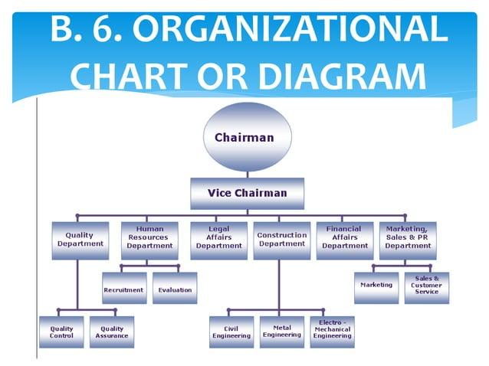
www.tuf.edu.pk
unioffaisalabad

Slide 16
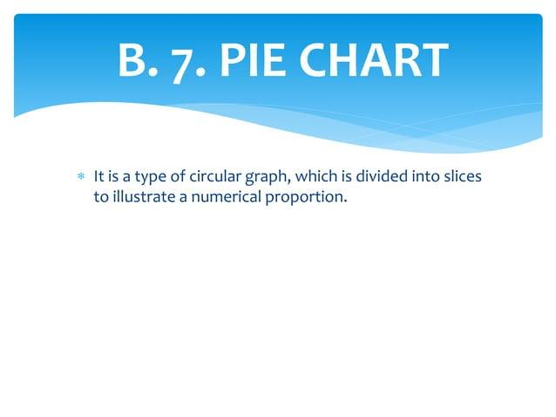
www.tuf.edu.pk
unioffaisalabad

Slide 17
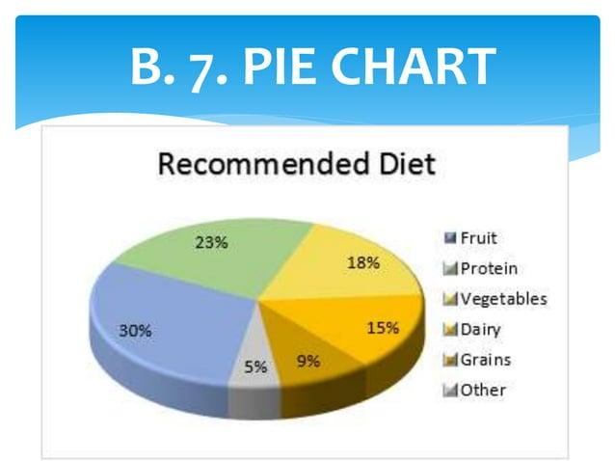
www.tuf.edu.pk
unioffaisalabad

Slide 18
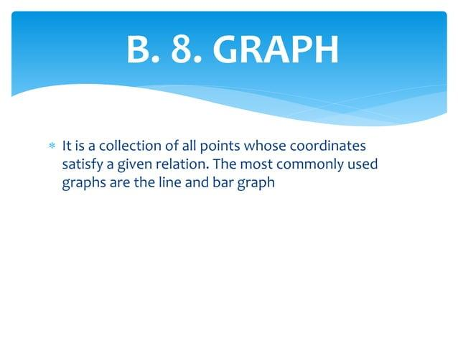
www.tuf.edu.pk
unioffaisalabad

Slide 19
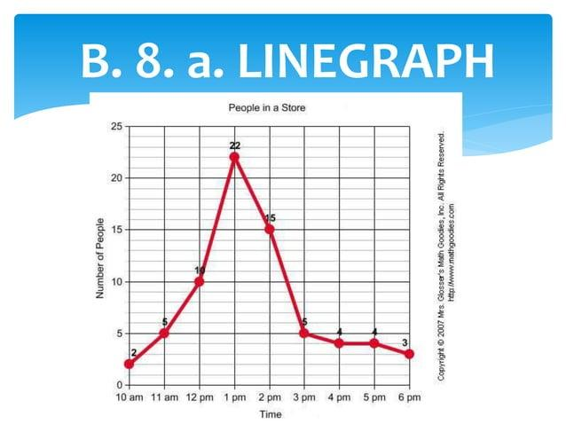
www.tuf.edu.pk
unioffaisalabad

Slide 20
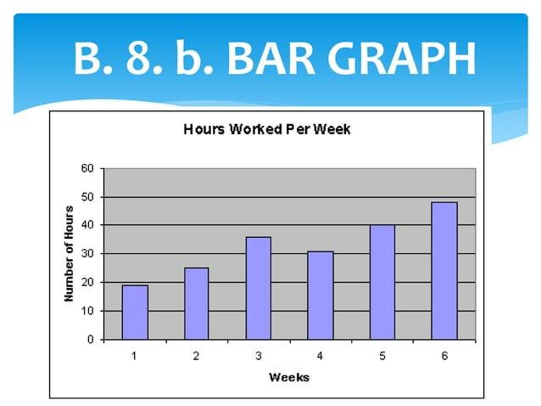
www.tuf.edu.pk
unioffaisalabad

Slide 21
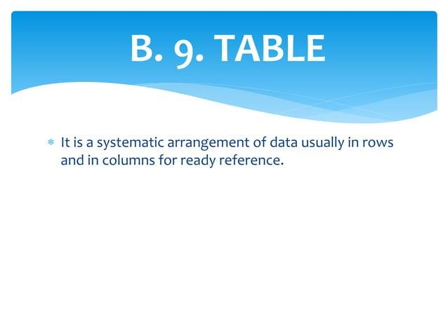
www.tuf.edu.pk
unioffaisalabad

Slide 22
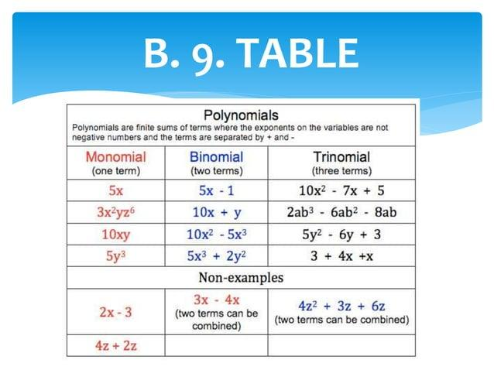
www.tuf.edu.pk
unioffaisalabad

